Slide 1
Travel Planner Agent
CAPSTONE PROJECT
Presented By:
Pratham Sharma-Maharaja Surajmal Institute of Technology-Electronics and Communication Engineering

Slide 2
Problem Statement
Planning travel itineraries is a time-consuming and often overwhelming task for many users. It requires browsing multiple websites to check accommodation options, transport routes, local weather, and activity suggestions. Additionally, constraints such as budget, time, and user preferences complicate the planning process further.
Many users, especially those with little experience or limited time, cannot efficiently access personalized travel planning resources. The goal is to eliminate manual research and automate the generation of day-wise plans based on simple input like location, dates, and budget.
A seamless, intelligent agent is needed to help users plan trips effortlessly using their preferences like location, budget, duration, and time of travel.

Slide 3
Proposed Solution
The solution is an AI-powered Travel Planner Agent that utilizes IBM Watsonx.ai and Watsonx Assistant to interact with users and generate detailed, budget-conscious travel itineraries.
It takes natural language inputs from users and uses the Granite LLM model to generate suggestions for daily activities, accommodation, and travel tips. The assistant optionally fetches real-time weather information via OpenWeatherMap and enhances response generation.
The entire system works without writing code, allowing non-developers to build powerful AI-driven tools quickly.

Slide 4
System Approach
The system uses a modular architecture based on the IBM Cloud platform and integrates external APIs for contextual enhancements.
• IBM Cloud Lite for backend services
• Watsonx Assistant for managing dialog flow and user interaction
• Watsonx.ai Granite model to generate contextual and intelligent travel plans
• Optional integration of OpenWeatherMap and Amadeus APIs for real-time weather and travel info
No frontend is used; all operations are handled in the backend with response generation and delivery directly through Watsonx Assistant.

Slide 5
Algorithm & Deployment
Algorithm Strategy:
• Slot filling in Watsonx Assistant to extract user input (destination, duration, budget, month)
• Input passed into a dynamic prompt sent to Watsonx.ai's Granite model
• Prompt returns a structured, context-aware, day-wise itinerary
Prompt Template:
"Create a {{duration}}-day itinerary for {{destination}} in {{month}} within ₹{{budget}}. Suggest daily activities, transport, stays, and include weather if available."
Deployment:
• Deployed completely within IBM Cloud using no-code Watsonx stack
• Webhook configuration optional for real-time weather API
• Responses formatted and shown in Watsonx Assistant interface

Slide 6
Result
The AI agent produces day-wise itineraries like this:
Example:
Day 1: Arrive in Goa, relax at Baga Beach, try local seafood.
Day 2: Trek to Dudhsagar Falls, spice plantation tour.
Day 3: Visit Anjuna market, explore Fort Aguada, fly back.
Stay: Budget hostel ₹1000/night. Meals ₹500/day.
Weather: Sunny, 30°C.
The model-generated output is relevant, clear, and adaptable to user constraints. Real-time data (weather) adds personalization and practicality.

Slide 7
Conclusion
The Travel Planner Agent successfully demonstrates the capability of no-code AI development using IBM Watsonx.ai and Assistant. It offers practical, user-specific travel plans without requiring code, frontend, or prior development knowledge.
It shows how AI can enhance daily life through intelligent planning, and how natural language interaction can simplify otherwise complex workflows.
Challenges included designing a balanced prompt that delivers detailed output and integrating external data via optional webhooks.

Slide 8
Future scope
The project can evolve into a multi-modal, multilingual, and scalable assistant by incorporating the following:
• Integration with real-time flight and hotel booking APIs
• Voice interaction support using speech-to-text modules
• Multilingual output generation using translation APIs
• Adding user profiles to remember preferences and past trips
• Deploying on messaging platforms like WhatsApp or Telegram
It can also be expanded for business travel, group tours, and educational excursions.

Slide 9
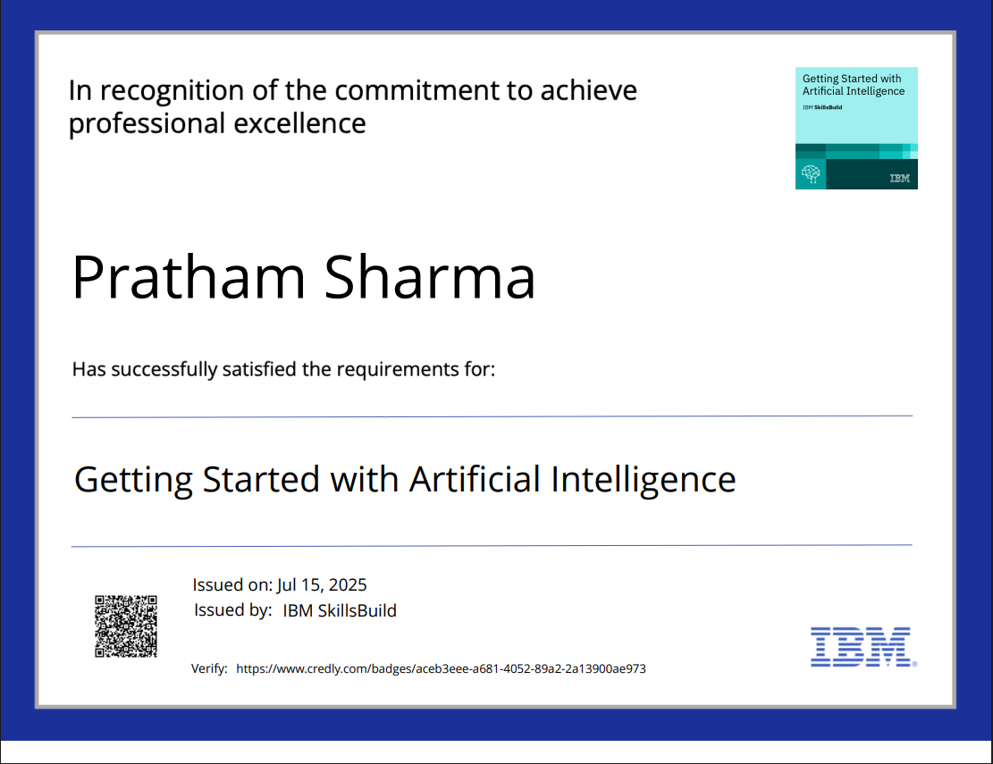
IBM Certifications

Slide 10
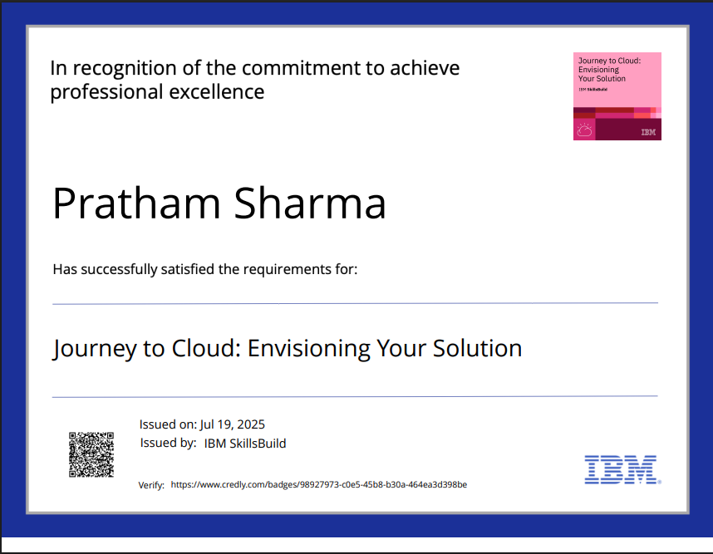
IBM Certifications

Slide 11
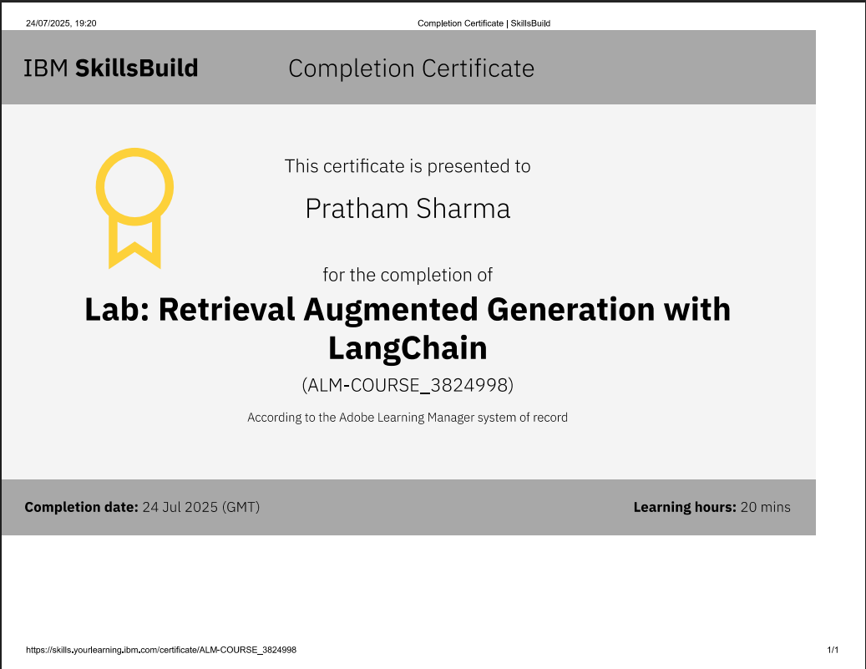
IBM Certifications

Slide 12
THANK YOU

